Slide 1
Combs Park
Preliminary Master Plan
Listening Session May 18, 2017

Slide 2
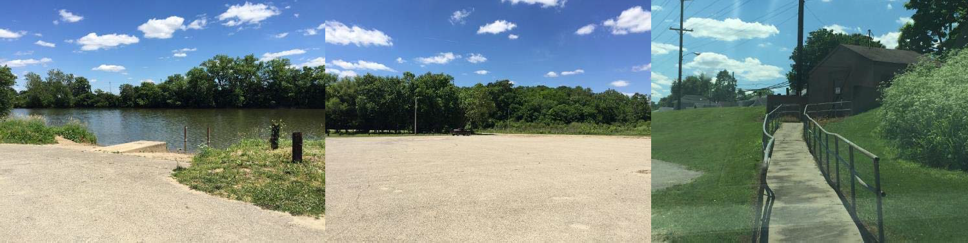
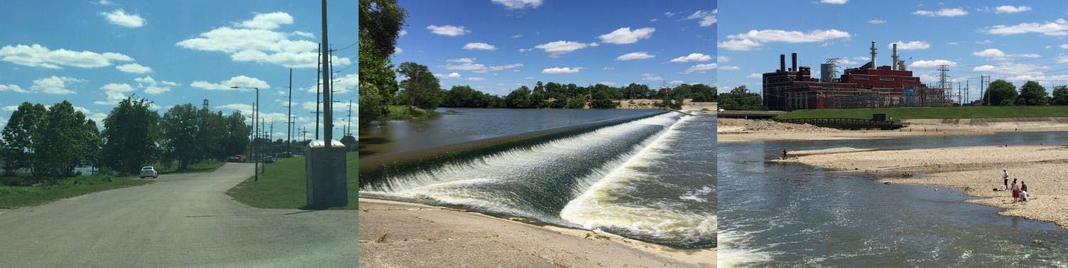
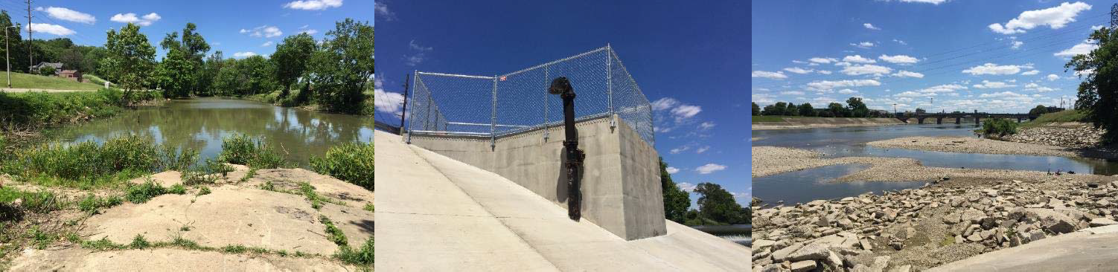





Slide 3
Outline
Why are we here tonight?
What will we be doing?
Master Plan Process
About Combs Park
Goals and Objectives
Preliminary Master Plan Overview
Breakout Groups

Slide 4
Why Are We Here Tonight?
Because you care about Combs Park and your community. Thank you for being here.
Because a vision plan is needed…
  To learn what’s feasible
  To guide phased park investment for the next 10+ years
  To use in obtaining grants and/or sponsorships
To show you how your input has been reflected in the draft plan and give you the opportunity to provide feedback.

Slide 5
Outline
Why are we here tonight?
What will we be doing?
Master Plan Process
About Combs Park
Goals and Objectives
Preliminary Master Plan Overview
Breakout Groups

Slide 6
What will we be doing?
We will:
  Review the Master Planning Process
  Review some quick facts about Combs Park
  Talk about the Goals and Objectives for the Master Plan that were developed based on the previous Listening Session
  Take a tour of the Preliminary Master Plan
  Gather at several tables to get your feedback / comments / likes / dislikes

Slide 7
Outline
Why are we here tonight?
What will we be doing?
Master Plan Process
About Combs Park
Goals and Objectives
Preliminary Master Plan Overview
Breakout Groups

Slide 8


Master Plan Process
We are here
Existing Conditions Inventory
OpportuniLtisiteensing
Listening
Prelim^{Ses}i^{s}n^{ion}ary Master Plan
and
Session
Goals and Objectives
Final Master Plan
Challenges Analysis

Slide 9

Schedule*
Existing Conditions Inventory
Opportunities and Challenges Analysis
First Listening Session Goals and Objectives
November 2016
December 2016
January 2017
February 2017

Slide 10
Schedule*
Preliminary Master Plan
Second Listening Session
Final Master Plan Approvals
*Subject to change
March-April 2017
May 2017
June-July 2017
Aug-Sept 2017

Slide 11
Outline
Why are we here tonight?
What will we be doing?
Master Plan Process
About Combs Park
Goals and Objectives
Preliminary Master Plan Overview
Breakout Groups

Slide 12
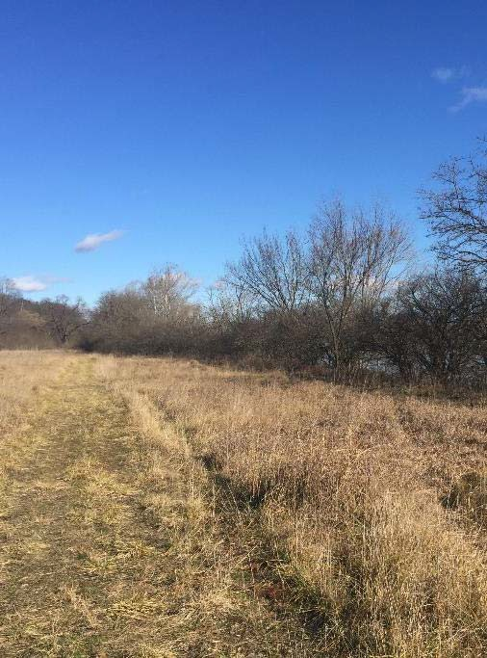
About Combs Park
Area: 65 acres
Owned by Miami Conservancy District
City of Hamilton leases the land from Miami Conservancy District
Named for James G. Combs, a Hamilton resident who died in 1961 assisting boaters who had gone over the low dam

Slide 13




Partners
Agency Hamilton Parks Conservancy
Miami Conservancy District
City of Hamilton
MetroParks of Butler County
Role
Non-profit organization managing Hamilton’s parks, including Combs Park
Land owner, permitting/ leasing agency, flood control
Lease holder
Park planning support

Slide 14
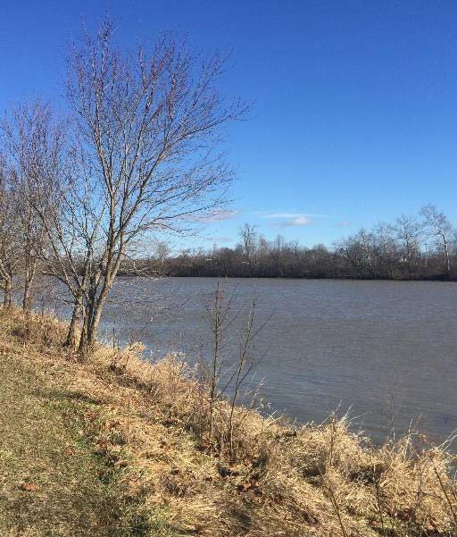
Flood Plain Issues
Combs Park is subject to frequent flooding
Flooding is a constant maintenance issue
Flood plain regulations require hydraulic modeling any time fill or structures are placed in the flood plain, to ensure flooding is not worsened and to protect public safety

Slide 15
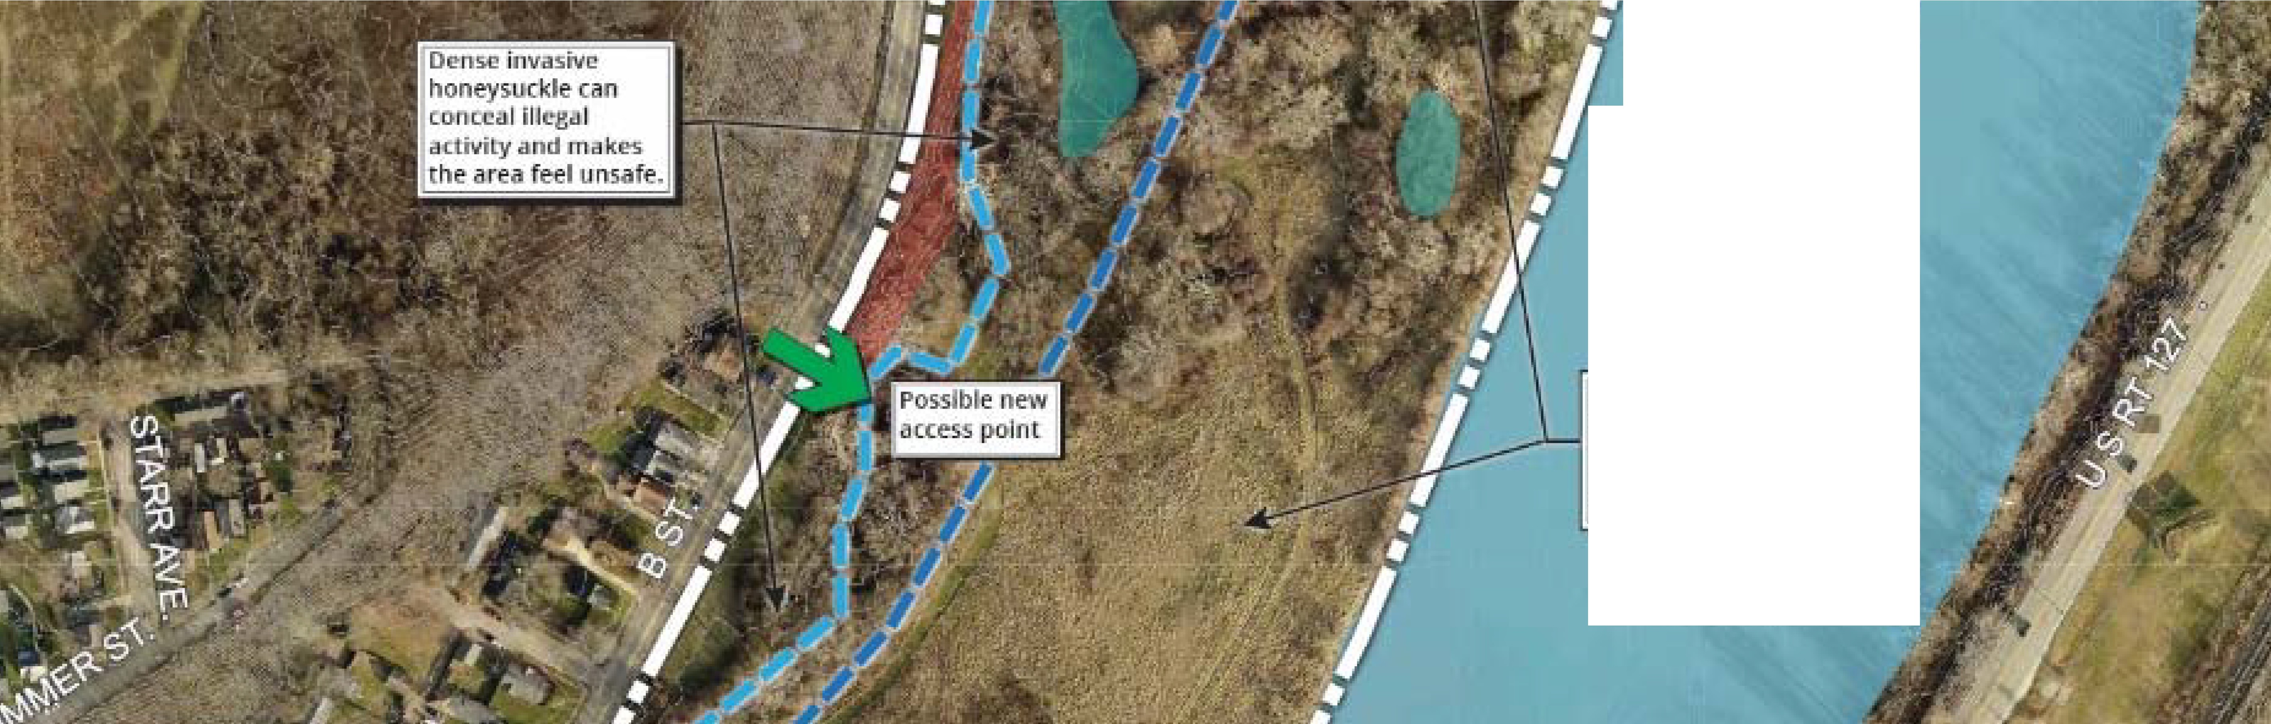

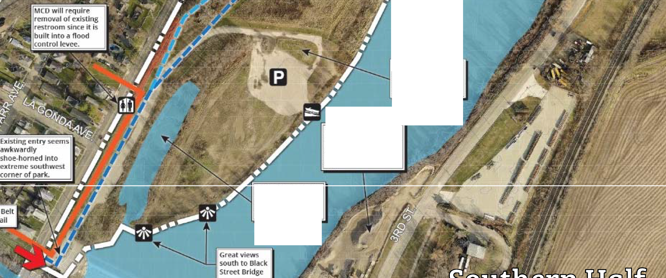
....
.§
Mi?mluws could potentially be &1h,mced as pra lrles,w provide ul!U r binJ andl
ol lillli!itor habitat
!Ve'hIdes driving over Ulllci:ubed gra:ss i:slaflcl hm1e lumet.l it
lrito a mud pit.
sand and gravel
miniri-g d ire ct ly aor,os:s river presefl ts nolse isi.ue d flt1 unp iedsant il p p<ei!fi !n c:e
PoLenlial ta exi,,and
existing 'In let for JI.OSsillt sma ll W,i!terfcra ft !!ls.e?

Slide 16
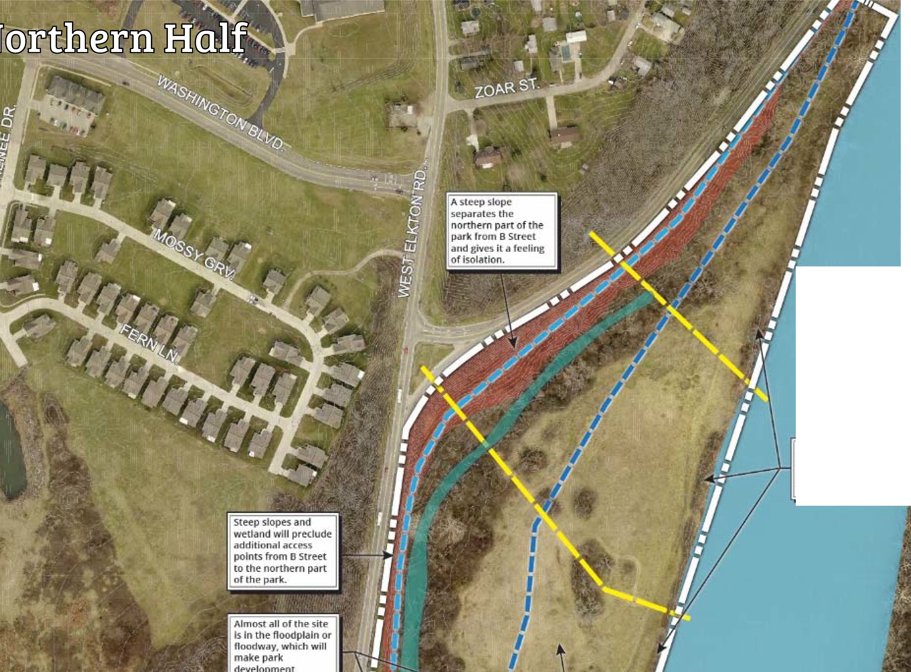
trw 115iVP '10 11 ys11c le
,11long rll/e;rban k can
...,_ - - T l ll l)e removed to open
LIFJ 11i ver v i,ew 5.

Slide 17
Outline
Why are we here tonight?
What will we be doing?
Master Plan Process
About Combs Park
Goals and Objectives
Preliminary Master Plan Overview
Breakout Groups

Slide 18
Basis for Goals and Objectives
Input from previous Listening Session and comments submitted online
Existing site conditions
Site opportunities and challenges
Not necessarily ordered by priority

Slide 19
What We Heard
Most Desired Uses
Bird Watching
Natural Trail
Fishing
Prairie
Trail Along the Creek
Bike Riding
Sitting Along the River
Kayaking
Least Desired Uses
Playground
Soccer
Concert Stage
Splash Pad
Fountain
Pavilion

Slide 20
Master Plan Goals
Create a unique destination that builds on the park’s riverfront location and natural assets
Enhance access for park users of all ages and abilities
Integrate Combs Park with the proposed Belt Line Trail and take advantage of its potential to be a major trailhead

Slide 21
Master Plan Goals
Protect and enhance the park’s natural resources while improving the public’s ability to access, enjoy, and learn about them
Design with maintenance in mind, especially considering frequent flooding
Create an environment that improves the
perception of safety

Slide 22
Other Considerations
Guiding document for 10+ years
Improvements will be phased in over time
Priority considerations
  Greatest impact on park attractiveness / usability for lowest cost
  Grant / sponsorship opportunities
  Balance with investment at other parks
  Be flexible – take advantage of opportunities

Slide 23
Outline
Why are we here tonight?
What will we be doing?
Master Plan Process
About Combs Park
Goals and Objectives
Preliminary Master Plan Overview
Breakout Groups

Slide 24

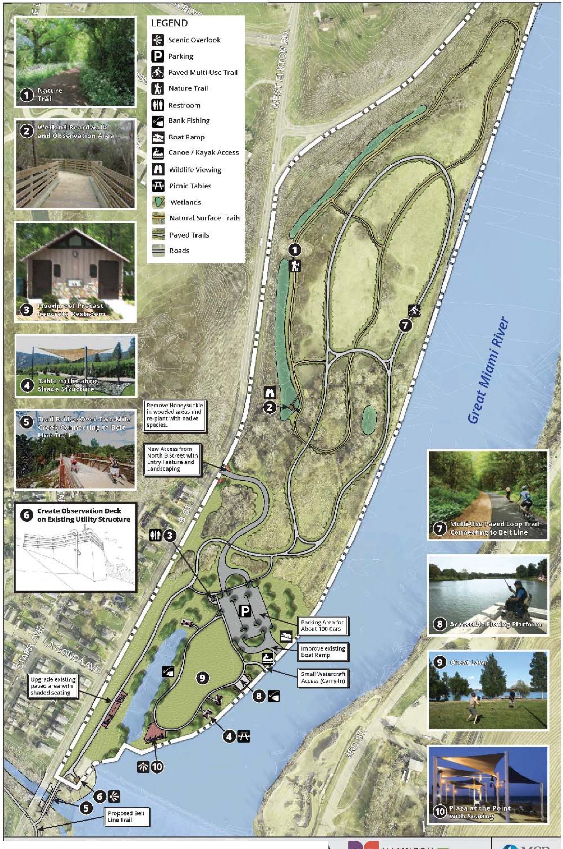


Slide 25
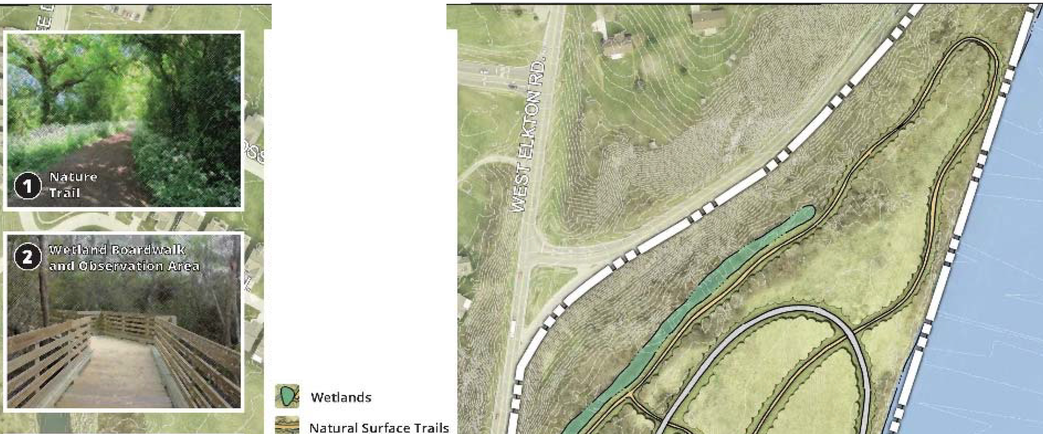

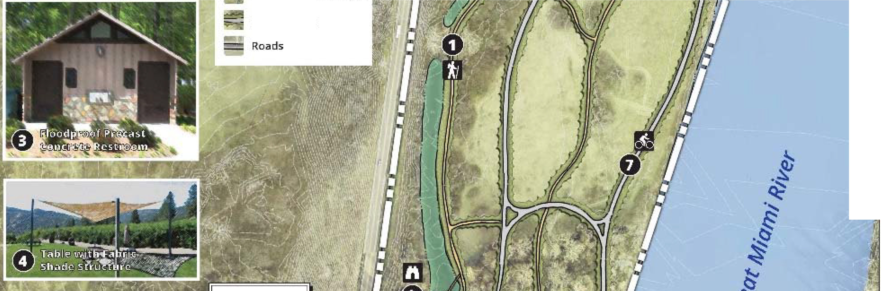
LEGEND
B Scenic Overlook
l]iJ Pa rk in g
II Paved Multi-Use Trail
El Nature Trail
II] Restroom
Bank Fishing
9 Boat Ramp
Canoe I Kayak Access
m P icn ic Tab le s
[i] WIidii fe View i ng
Pav ed TraHs

Slide 26
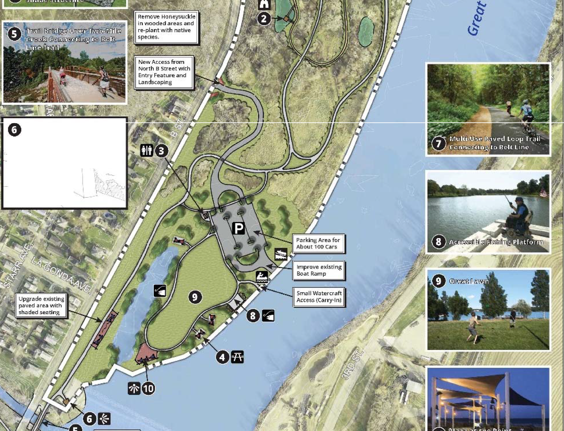
Create Observatiol"I PBck on Existing Udllty structure
E-- - - -- ----¥-
- L..
--
i I
,--
, '9
-- ---J.₋ 1"'
-- "----

Slide 27
Key Features
1.1-mile paved multi-use trail connecting to proposed Belt Line Trail
0.9-mile nature trail loop with access to wetlands
Wetland boardwalk and observation point
New, improved access from North B Street about 0.3 miles north of existing access
Existing park road incorporated into multi- use trail

Slide 28
Key Features
Great Lawn with perimeter walking trail loop
Seating and tables with fabric shade structures
“Plaza at the Point” with shaded seating
Add observation deck to existing utility structure at Two Mile Creek

Slide 29
Key Features
Accessible fishing platform
Improved parking and boat ramp
Carry-in watercraft access point
Floodproof precast concrete restroom

Slide 30
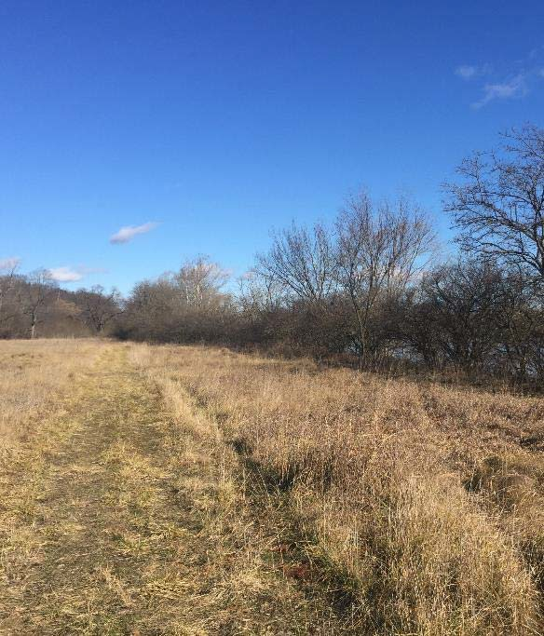
Habitat Restoration Goals
Preserve and enhance habitat
Increase species diversity
Manage invasive species

Slide 31
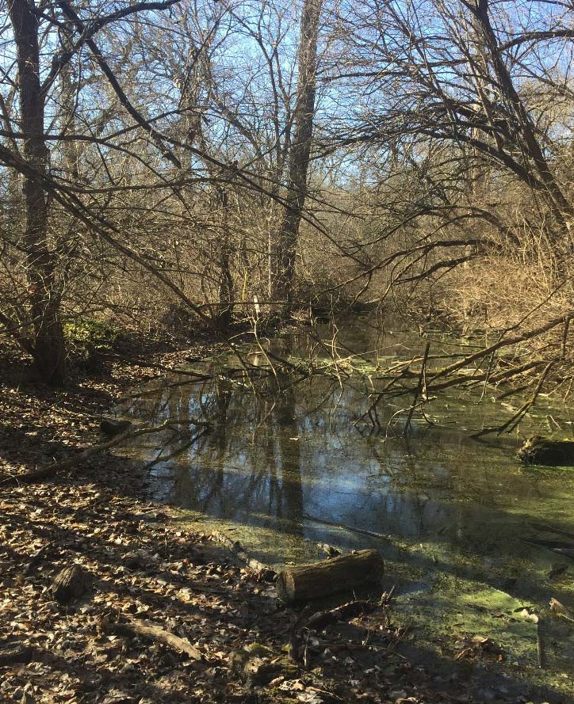
Habitat Restoration Recommendations
Remove honeysuckle and replant with native species
  Has the added effect of improving visibility and safety
Prairie reconstruction / meadow enhancement
  Helps pollinators
Wetland enhancement

Slide 32
Other Recommendations
Longer lease term is needed to justify major capital investment.
  The land comprising Combs Park is currently being leased from MCD for a five-year term (renewable).
  Lease terms should address proposed improvements.

Slide 33
Outline
Why are we here tonight?
What will we be doing?
Master Plan Process
About Combs Park
Goals and Objectives
Preliminary Master Plan Overview
Breakout Groups

Slide 34
Breakout Groups
4 tables, 20 minutes
All have copies of Preliminary Master Plan
Tell us what you like / dislike, what is missing
Draw on plans, write notes, use post-its
Comments recorded on easel pads
Ask questions of facilitators
(Respectfully) discuss ideas with your group
Report out to large group

Slide 35
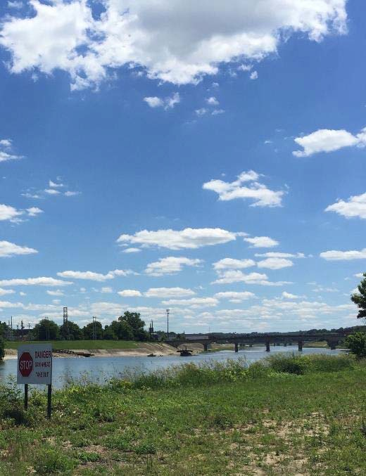
Thank You!
We recognize that your time is valuable
Thank you for choosing to spend it with us to help shape your future park

